Slide 1

Measures
of
Location
By
Saujanna Jafreen
Lecturer
Department of Natural sciences

Slide 2
Measures of Location
At the end of this session the participants should be able to:
 explain why summary measures are needed;
 Compute Centiles and explain their uses;

Slide 3
Measures of Location
Measures of Location
1. Percentiles
2. Deciles
3. Quartiles

Slide 4
Percentile
When a distribution is divided into 100 equal parts , each division is called a percentile. So, there are 99 percentiles in a distribution denoted by P1,P2,……,P99.

Slide 5
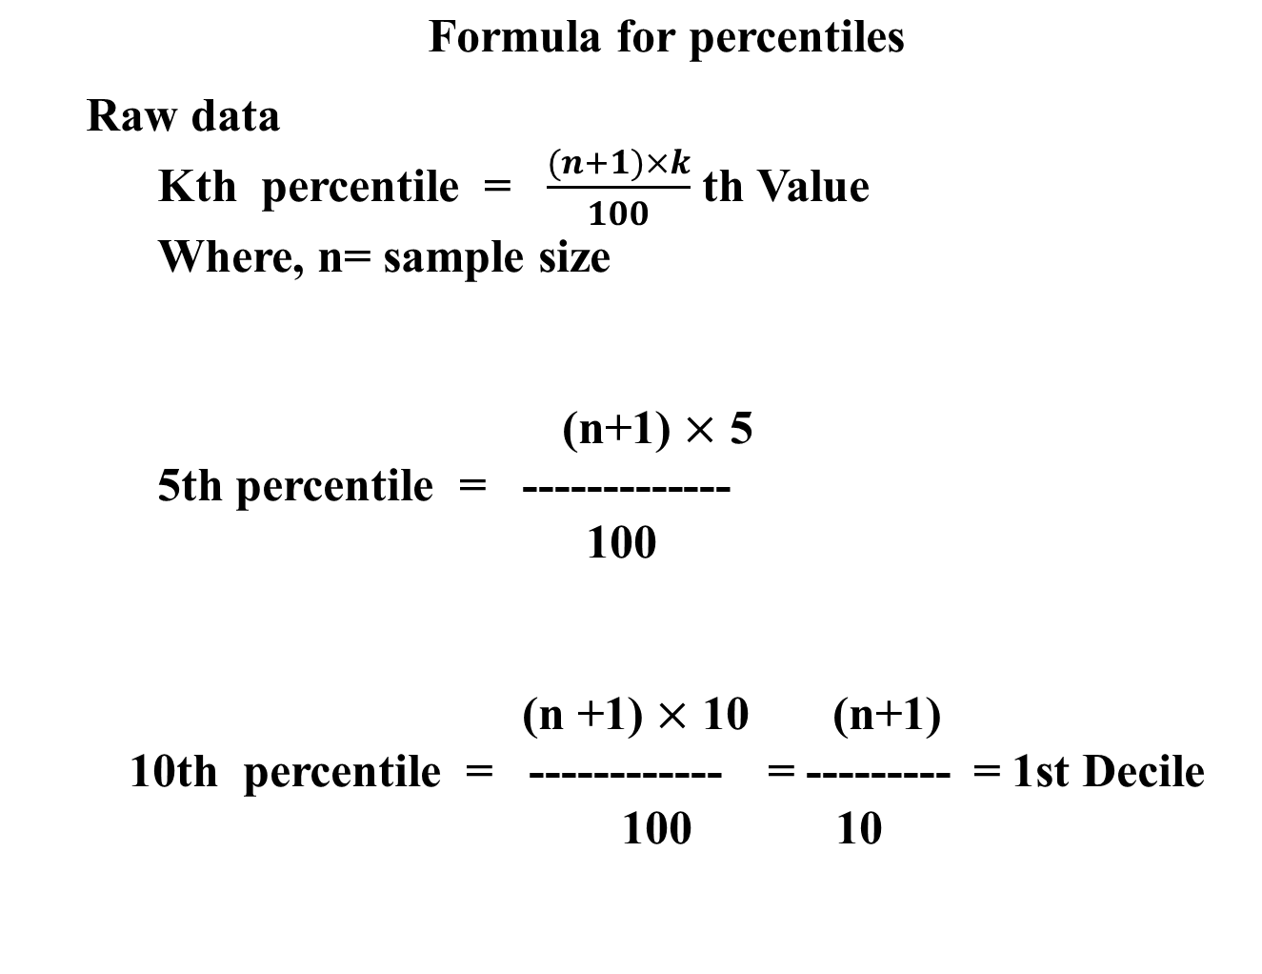

Slide 6
(n +1) × 25 n+1
25th percentile = ------------ = -------- = Q1
100 4
(n +1)×50 n+1
50th percentile = ------------ = -------- = Q2 = Median
100 2
(n +1) ×75 3( n+1)
75th percentile = --------------- = ----------- = Q3
100 4

Slide 7
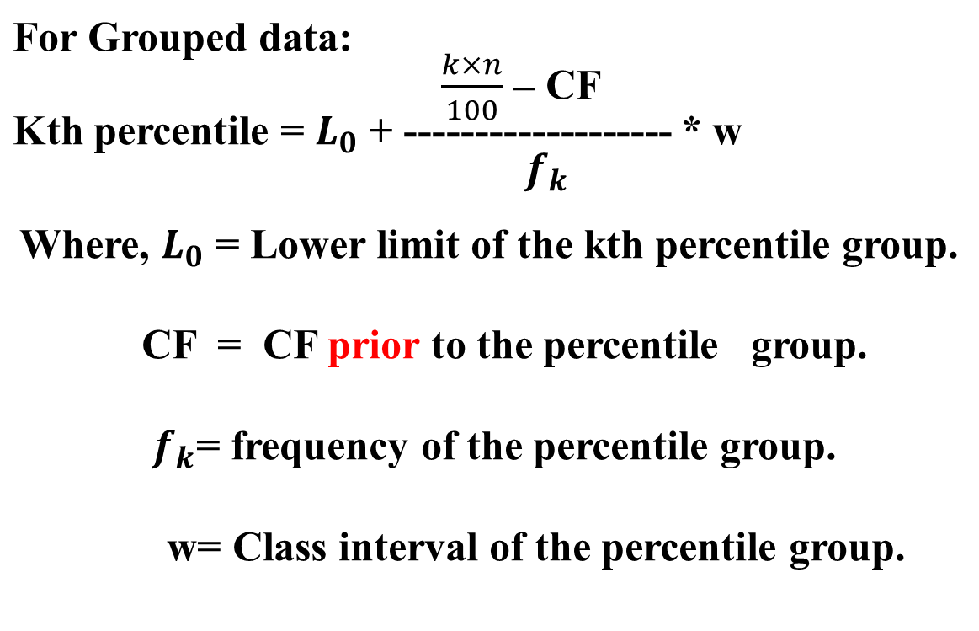

Slide 8
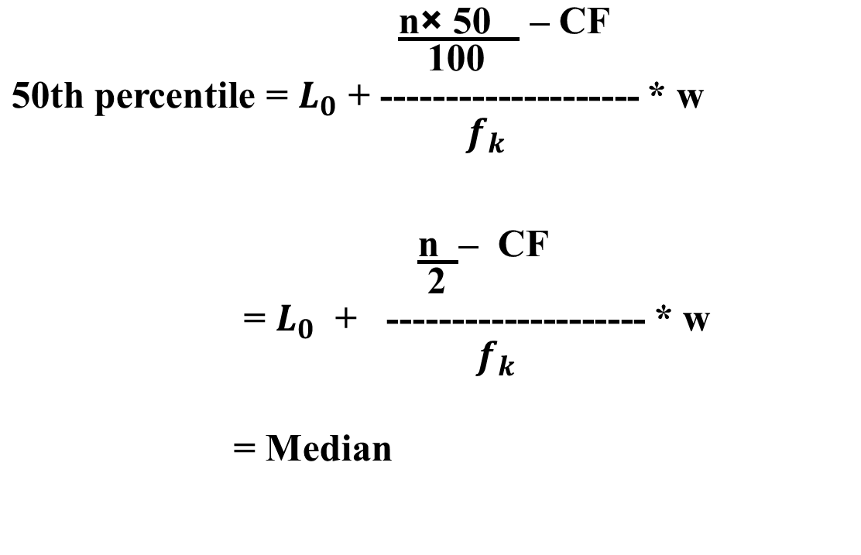

Slide 9
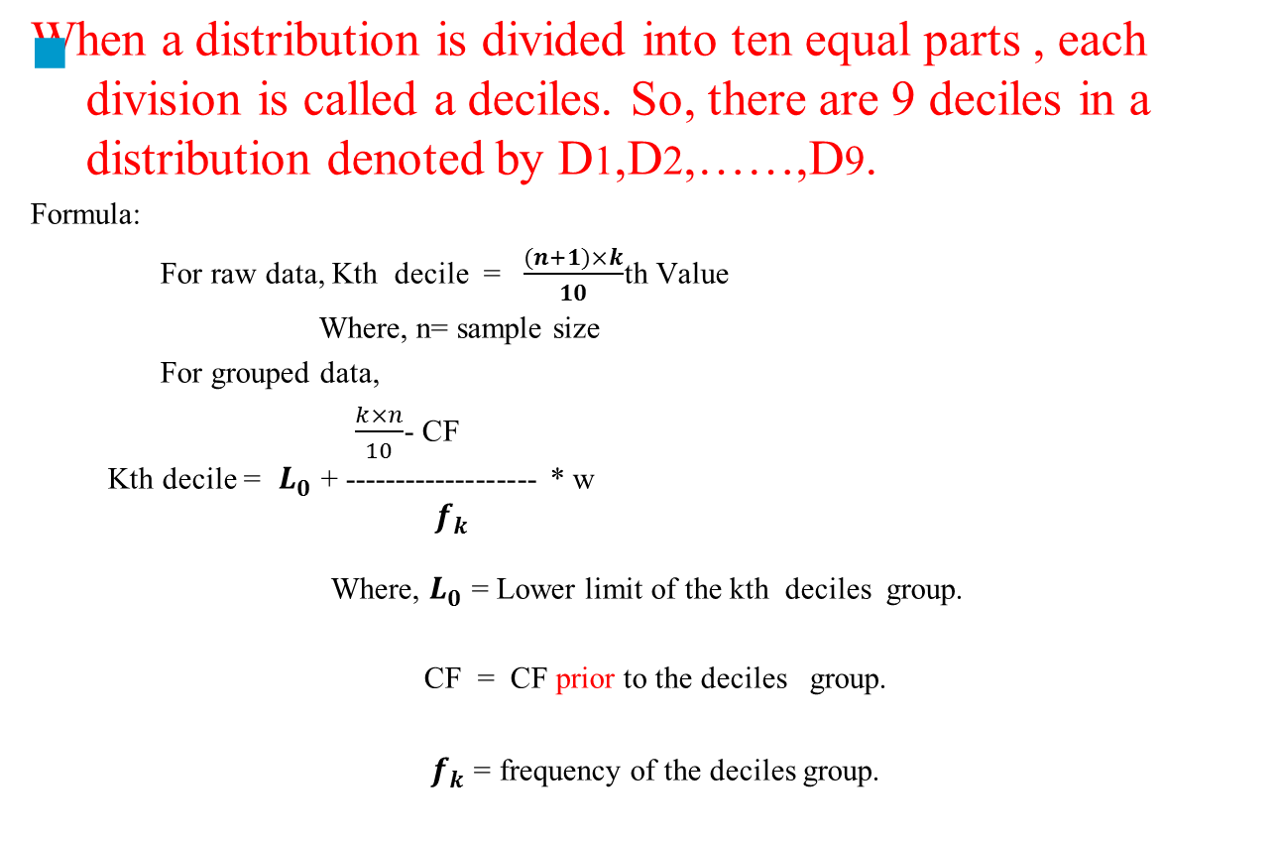
Deciles

Slide 10
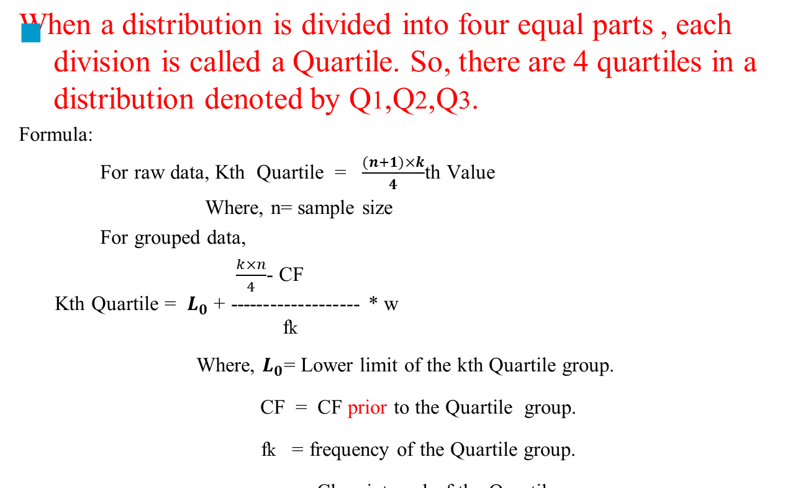
Quartiles

Slide 11
Let us consider, marks of 20 students in a mid term examination are given bellow-
15,12,13,13,15,12,13,11,8,8,6,3,15,9,12,15,1315,14,8.
arrange them in ascending order
3,6,8,8,8,9,11,12,12,12,13,13,13,13,14,15,15,15,15,15.

Slide 12
5th percentile=5*(20+1)/100=1.05th value=3
25th percentile=25*21/100=5.25th value=8
3rd deciles=3*21/10=6.3th value=9
3rd quartile=3*21/4=15.75th value=15

Slide 13
Mean, Median, Mode from Grouped Data
Height of 100 students are as below:
Height (cm) f CF
110-115 1 1
115-120 4 5
120-125 10 15
125-130 20 35
130-135 30 65
135-140 20 85
140-145 10 95
145-150 4 99
150-155 1 100
Total 100

Slide 14
35th Percentiles(here, percentile class is nk/100 in CF) (k=35)
=125+ 35-15 * 5
20
=130
9th deciles(here, deciles class is nk/10 in CF)(k=9)
=140+ 90-85 *5
10
=142.5

Slide 15
  Box and Whisker plot
  Prepared based on Raw data.
  Five measures are needed.
  These are:
  Minimum and Maximum values,
  and Q1, Q2, Q3.

Slide 16
Steps:
1. Arrange data in ascending order.
2. Represent the data on the horizontal axis.
3. Find Maximum and Minimum values and
compute Q1,Q2 and Q3 of the data set.
4. In the space above the horizontal axis mark
the points that aligns with Minimum, Maximum, Q1, Q2 and Q3 of your data set.
5. Draw a box in the space above the horizontal axis that pass through the two points that aligns with Q1 and Q3.
6. Divide the box in two parts drawing a vertical line from the point that aligns with Q2.
7. Draw a line from the point that aligns with the minimum value to left end of the box and
another one that aligns with the maximum point to the right end of the box.
These lines are called whiskers.

Slide 17
Draw a Box Plot for the following data
Exam number of the 20 students in their quiz are given bellow:
x: 0.5 1.2 2.1 2.5 2.5 3.0 3.8 4.0 4.2
4.5 5.0 5.0 5.0 5.0 6.0 6.5 7.0 8.0
9.5 13.5

Slide 18
Solution:
Here, Minimum value= 0.5
Maximum value= 13.5
As we know, Qk = {(n+1)*k}/4
So, Q1= (20+1)*1/4 = 5.25 th value
= 5 th value
=2.5
Q2 = (20+1)*2/4 = 10.5 th value
= 11 th value
=5
Q3 = (20+1)*3/4 = 15.75 th value
=16 th value
= 6.5
0.5 2.5 5 6 13.5

Slide 19
Interpretation
The box plot is interpreted as follows:
The box itself contains the middle 50% of the data. The upper edge of the box indicates the 75th percentiles of the data set and the lower hinge indicates the 25th percentile. The range of the middle two quartiles is known as the inter- quartile range.
The line in the box indicates the median value of the data.
If the median line within the box is not equidistant from the hinges, then the data is skewed.
The ends of the vertical lines or ‘whiskers’ indicate the minimum and maximum data values
The points outside the ends of the whiskers are outliers or suspected outliers.

Slide 20
Advantages
Box plot have the following strengths:
Graphically display a variables location and spread at a glance
Provide some indication of the data’s symmetry and skewness.
Unlike many other methods of data display, box plot show outliers
By using a box plot for each categorical variable side by side on the same graph, one quickly can compare data sets.

Slide 21
Thank you

